Slide 1


Erik Blake
March 10, 2025

Slide 2

Outline
Executive Summary
Introduction
Methodology
Results
Conclusion
Appendix

Slide 3
Executive Summary
This analysis aims to determine factors which predict whether a Falcon 9 First Stage will land or not. By leveraging exploratory analysis and machine learning, we identify features most critical to the overall success of the launch
Key findings:
Experiential Learning - Landing success improved significantly over time suggesting that SpaceX learned from past failures
Orbit Complexity - There is a significant difference in landing success based on orbit type
82% of failed landings occurred for either GTO or ISS obit types, suggesting unique challenges for these trajectories
Launch Site Differences – Landing success appeared to be influenced by where the rocket launched, suggesting regional factors such as weather, launch pad, launch team, etc.
Model Accuracy – A reliable machine learning model was developed to predict first stage landing success with 87% accuracy to unseen data
Impact
These findings suggest that we can not only understand and predict whether the first stage lands successfully, but we can also predict the cost associated with future launches allowing Space Y to make competitive bids moving forward. Approximate cost could approach $35M (see appendix for calculation)
Notes:
Period at the end of launch
Take the “was” out of the sentence, “landing success was appeared to be influenced”
In the impact section, “but we can also predict the cost”

Slide 4
Introduction
Commercial space travel is becoming more affordable and is seeing increased demand. Space X has been able to reduce the cost per launch significantly from ~$165M to ~$62M mainly due to figuring out how to reuse the First Stage. Space Y is looking to become more competitive in the market and has hired us to create a prediction model. If a model can determine if a First Stage can land, the cost to launch and land successfully can be calculated
The objective of this project is to
Explore Space X historical data to better understand patterns and trends
Develop a Machine Learning model that can predict if the First Stage will land successfully
Approximate the cost of a launch
Notes:
Period after calculated
Colon after “the objective of this project is to”

Slide 5

Section 1

Slide 6
Methodology
Executive Summary
Data collection methodology:
Describe how data was collected
Perform data wrangling
Describe how data was processed
Perform exploratory data analysis (EDA) using visualization and SQL
Perform interactive visual analytics using Folium and Plotly Dash
Perform predictive analysis using classification models
How to build, tune, and evaluate classification models
Notes:
How to build, tune, and evaluate

Slide 7
Data Collection
Data Collection of the SpaceX data was executed in two separate ways
Data was retrieved from an Application Programming Interface
Data was scraped from Wikipedia page using Beautiful Soup
API retrieval – High level summary
Retrieve a preliminary set of data IDs in the form of a Json file using a get function
Turn the IDs into a data frame to perform some preliminary data wrangling
Go back into the API with user designed functions to retrieve the desired information
Web scraping
Create a response object from a url page
Use Beautiful Soup to extract the table of interest from the object
Extract the desired information from each table header and append into a pandas df construct

Slide 8
Data Collection – SpaceX API
Get Response Object from API
Reformat file into Pandas Data Frame
Wrangle Data Frame for Pertinent Data IDs
Return to API and Collect Actual
Data
Construct Appended Data into Actionable Data Frame
View data collection details from SpaceX API in notebook on GitHub

Slide 9
Data Collection - Scraping
Get Response Object from URL
Extract HTML Table Headers from URL Object
Create Empty Dictionary with Pertinent Column Names
Extract Data from HTML Table into Dictionary
Construct Appended Data from Dictionary into Actionable Data Frame
9
View data collection details from SpaceX web scraping in notebook on GitHub

Slide 10
Data Wrangling
After collection from the API, data was processed as seen in the flowchart below
Filter Data Frame to Include Falcon 9 Booster Only
Identify Missing Data in the Data Frame
Replace Missing Data with Mean (Just Payload Mass)
Create Column to Indicate Class of Landing Outcome
View SpaceX data wrangling details in notebook on GitHub

Slide 11
EDA with Data Visualization
Data was visualized multiple ways to gain a preliminary understanding of the data
Scatter plots were used to visualize the following relationships
Payload Mass vs. Flight Number
Launch Site vs. Payload Mass
Orbit vs. Flight Number
Orbit vs. Payload Mass
Bar chart was used to show Success Rate vs. Orbit
Line chart was used to show Success Rate per year between 2010 - 2020
11
View SpaceX data visualization details in notebook on GitHub
Notes:
Add colon after relationships

Slide 12
EDA with SQL
Queries performed to explore the data were:
Unique names of the different launch sites
First five records that begins with ‘CCA’
Total payload mass carried by boosters launched by NASA CRS
Average payload mass carried by booster version F9 v1.1
Date of first successful landing on a ground pad
Names of booster carrying between 4000 – 6000 kgs with successful drone ship landings
Number of successful vs failed mission outcomes
View SpaceX data EDA details in notebook on GitHub
Notes:
Does launch sites need to be capitalized?

Slide 13
EDA with SQL (continued)
Additional queries performed to explore the data were:
Names of the boosters carrying maximum payload mass
Records of month name, landing outcome, booster version, and launch site, where the outcome was a failed drone ship landing in year 2015
Count of every landing outcome category within a specific date range, ranked in descending order
View SpaceX data EDA details in notebook on GitHub
Notes:
Does name, landing outcome, booster version, and launch site need to be capitalized?

Slide 14
Build an Interactive Map with Folium
Folium map was created to explore location details. The following objects were added to the map
Folium circles and markers were added to label and highlight the exact location of each site
Marker Clusters were added to show the successful and failed outcomes for each site
Polylines with distance markers were added to show the distance between various landmarks
Coastline
Train tracks
Hwy
City
View SpaceX Folium map details in notebook on GitHub
Notes:
A folium map was created
Period after details
Colon after “added to the map”
Marker clusters were added? Or Marker cluster was added

Slide 15
Build a Dashboard with Plotly Dash
Dashboard was created to explore various factors in the data interactively. The following components and graphs were added to the dashboard
Dropdown menu allowing user to select all sites or specific launch site
Pie chart that changes based on the dropdown menu selection
If ‘All’ selected, pie chart shows every launch site with their percentage of successful landings
If a specific site is selected, pie chart shows that sites proportion of successful to failed landings
Range Slider allowing user to adjust the payload range
Scatter Plot of Class vs. Payload Mass by Booster Version
Plot adjust based on both dropdown for site, and the range slider for payload
View SpaceX Dashboard on GitHub
View SpaceX Dash code on GitHub
Notes:
Colon after dashboard
If ‘all’ is selected
“Pie chart shows that site’s” instead of sites, I think

Slide 16
Predictive Analysis (Classification)
Prediction Analysis consisted of data preprocessing, model selection, model training, and model evaluation. The flowchart below shows more detailed steps
Create a Scaled Feature Dataset
Split Data into Training and Testing Datasets
Finetune Model Hyperparameters, Train, Cross-validate for
Logistic Regression
Support Vector Machine
Decision Tree
K Nearest Neighbor
Determine Accuracy for Test Dataset
Construct Confusion Matrix
View SpaceX Machine Learning details in notebook on GitHub

Slide 17
Results
Landing success improved over time (implies learning from each launch)
16% of launches did not attempt to land (Only used launches after first successful landing)
73% of all failed landings never attempted to land
60% of failed launches – Legs did not deploy
~20% of launches for CCAFS/KSC
10% of launches for VAFB (Though smaller sample - 1 out of 11)
Site
50 of 84 (60%) launches took place at CCAFS SLC-40 (66% Success Rate)
25% launches at KSC (77% Success Rate)
15% launches at VAFB (83% Success Rate)
77% of all failed landings occurred launching from CCAFS

Slide 18
Results (continued)
Orbit
50% of failed launches were of GTO orbit type
82% of failed launches were of either GTO or ISS orbit type
Orbit/Launch Site
90% of failures were either Launched at CCAFS site or destined to GTO orbit

Slide 19

Section 2

Slide 20
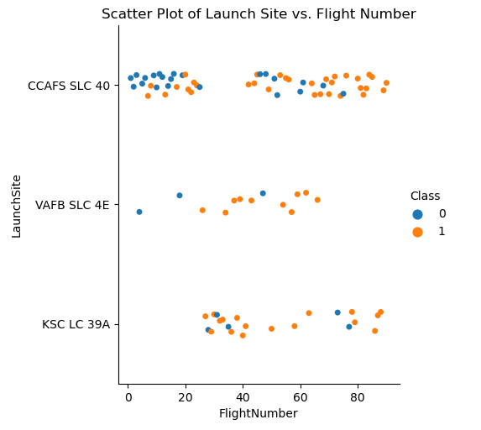
Flight Number vs. Launch Site
Graph of relationship between launch site and flight number
Most of the launches came from CCAFS SLC40
Percentage of failures appears to be higher for CCAFS SLC40
Most failed landings came from the earliest launches

Slide 21
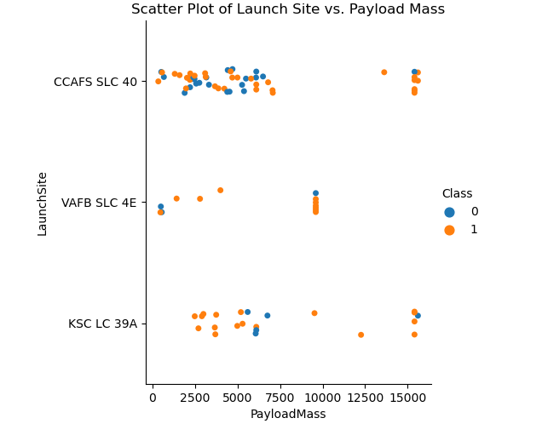
Payload vs. Launch Site
Graph of relationship between launch site and payload mass
Appears to show less failed launches above 8000 kgs

Slide 22
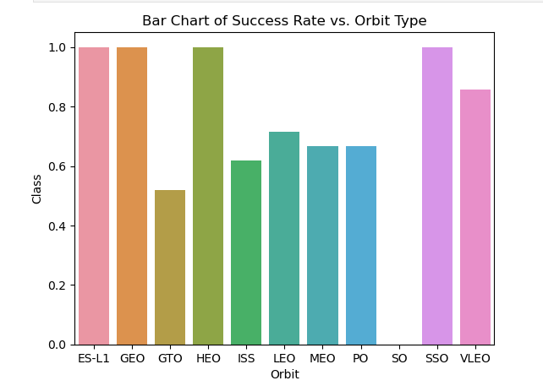
Success Rate vs. Orbit Type
Graph of success rate for each orbit type
Orbit ‘SO’ had no successful launches
Orbit ‘ES-L1’, ‘GEO’, ‘HEO’, and ‘SSO’ have 100% success rate

Slide 23
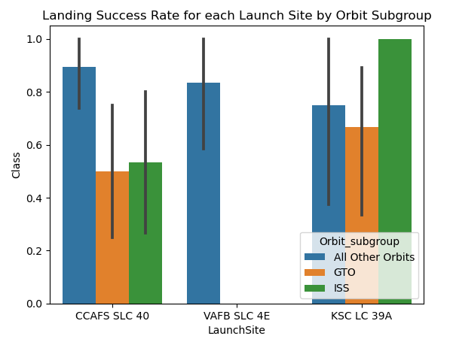
Success Rate vs. Launch Site (by Orbit)
Graph of success rate for each launch site by orbit
CCAFS has the lowest overall landing success rate
GTO orbit type has a low success rate regardless of site
ISS orbit type has a low success rate for one site but 100% for another

Slide 24
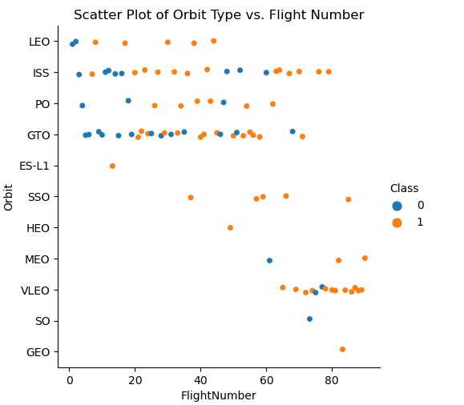
Flight Number vs. Orbit Type
Graph of relationship between orbit type and flight number
‘ES-L1’, ‘HEO’, ‘SO’, and ‘GEO’ only had 1 launch
‘SSO’ only multi-launch orbit with 100% success rate

Slide 25
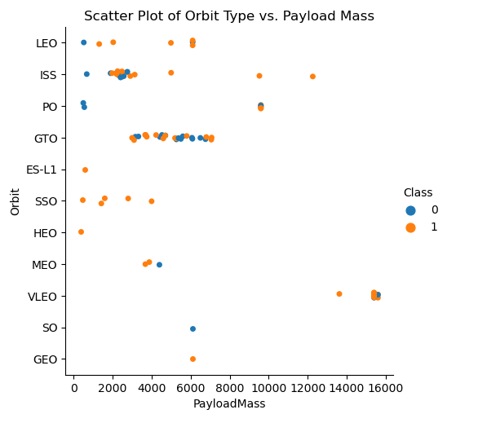
Payload vs. Orbit Type
Graph of relationship between orbit type and payload mass
Majority of launches carried less than 8000 kgs

Slide 26
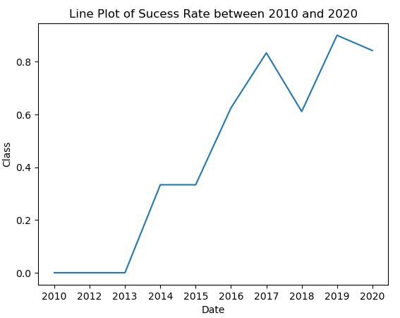
Launch Success Yearly Trend
Graph of the launch success rate over time (2010-2020)
No successful landings from the first three years
Upward trend in successful landings over time
2019 most successful year (~90%)

Slide 27
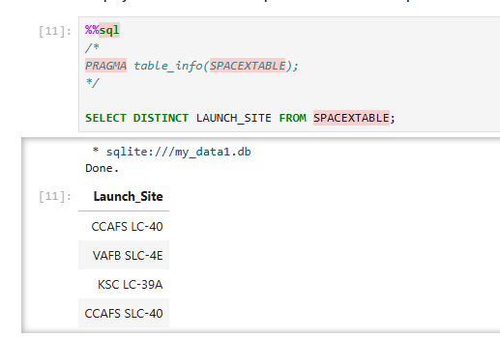
All Launch Site Names
Query of the unique SpaceX launch sites

Slide 28
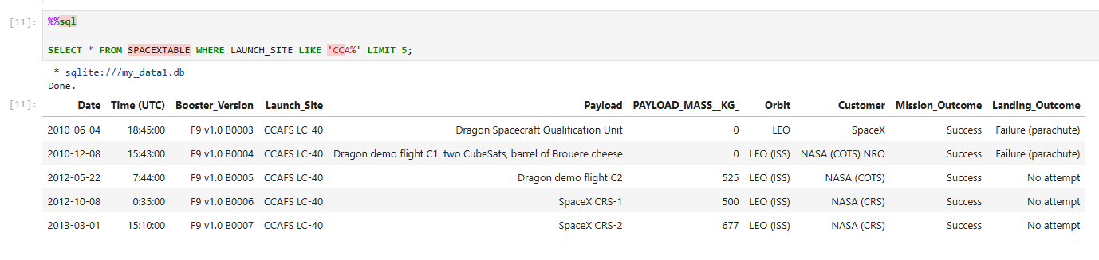
Launch Site Names Begin with 'CCA'
Query of the first five records that begin with ‘CCA’
Every record is from the same site (‘CCAFS LC-40’)

Slide 29
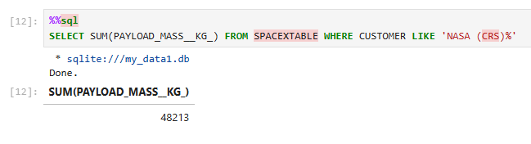
Total Payload Mass
Query of the total payload carried in kgs for all launches between the years 2010 and 2020

Slide 30
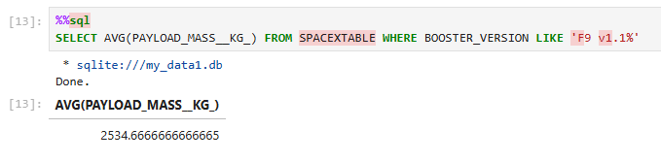
Average Payload Mass by F9 v1.1
Query of the average payload carried in kgs for all launches between 2010 and 2020

Slide 31
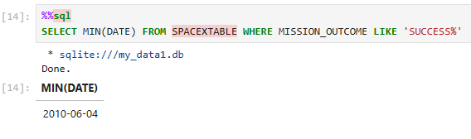
First Successful Ground Landing Date
Query of the first successful landing date

Slide 32
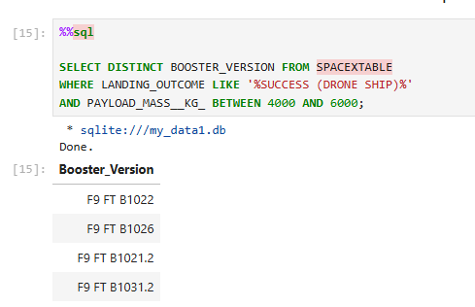
Successful Drone Ship Landing with Payload between 4000 and 6000
Query of names of boosters which have successfully landed on drone ship and had payload mass greater than 4000 but less than 6000

Slide 33
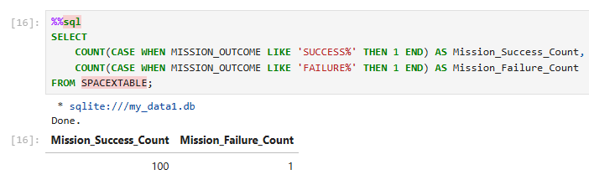
Total Number of Successful and Failure Mission Outcomes
Query of total number of successful and failed mission outcomes

Slide 34
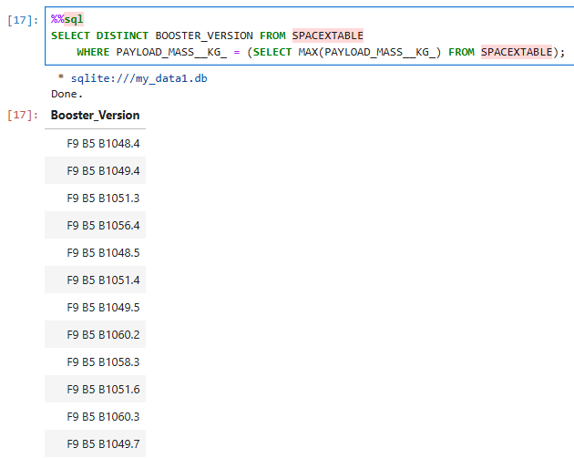
Boosters Carried Maximum Payload
Query of names of boosters which have carried the maximum payload mass

Slide 35
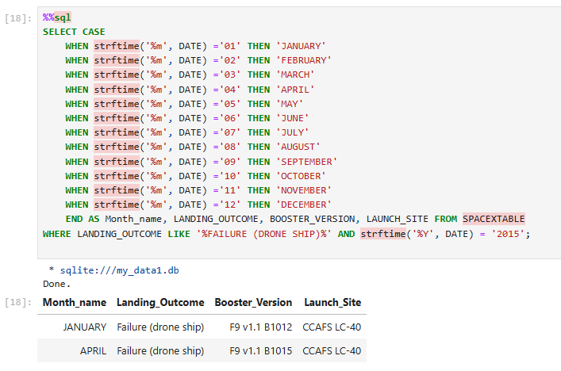
2015 Launch Records
Query of failed landing outcomes in drone ship, their booster versions, and launch site names for the year 2015
Notes:
Launch site names for the year 2015, instead of “in”

Slide 36
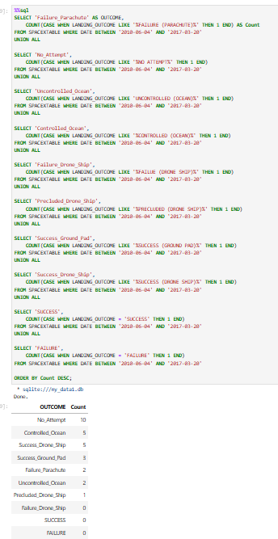
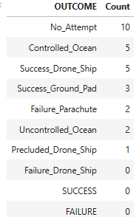
Rank Landing Outcomes Between 2010-06-04 and 2017-03-20
Query of ranked counts of landing outcomes between the date 2010-06-04 and 2017-03-20, in descending order
No landing attempt had highest count during this period
No drone ship failures during this period

Slide 37

Section 3

Slide 38
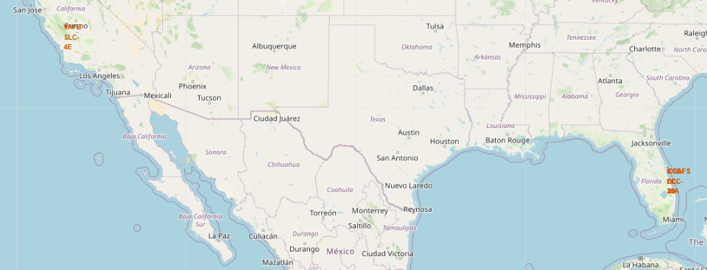
Location of Launch Sites
Image of markers on a Folium map showing the locations of the Launch Sites
Circles are present also and are visible when zoomed in to each location

Slide 39
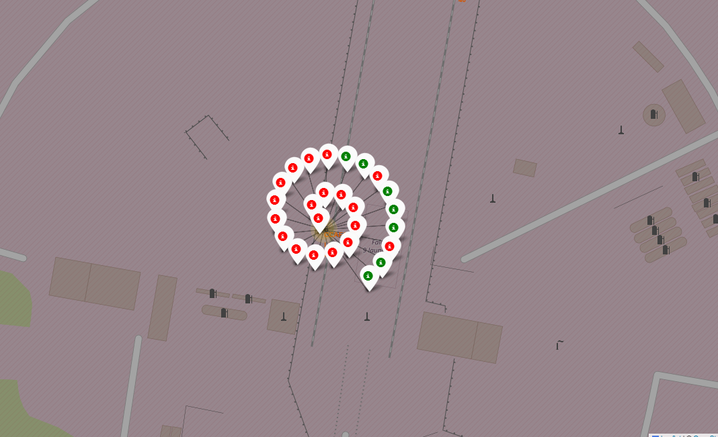
Marker Cluster of Landing Outcomes
Image showing the Landing outcomes for one of the launch sites
Red – Failed landing
Green – Successful landing
Notes:
Does landing need to be capitalized?

Slide 40
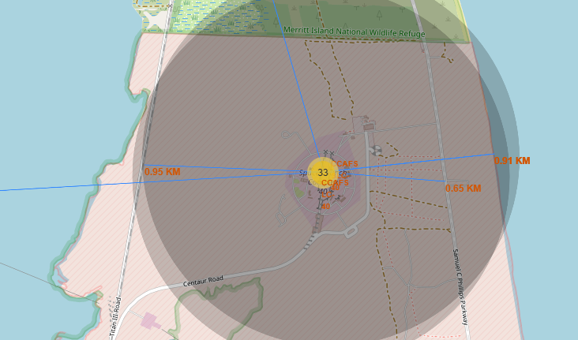
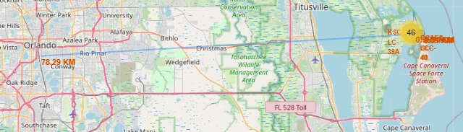
Launch Site Distance to Landmarks
Image showing a launch site with attached polyline marking distance between coastlines, train tracks, highways, and cities
All sites are relatively close to coastlines and train tracks
All sites are relatively distance from major cities

Slide 41

Section 4

Slide 42
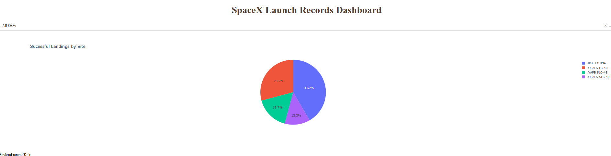
Dashboard – Successful Landing for All Sites
Image shows the percentage of successful landings across the four launch sites
KSC LC-39A has percentage of successful landings with 47%
VAFB has the lowest percentage of successful landings with 16%

Slide 43
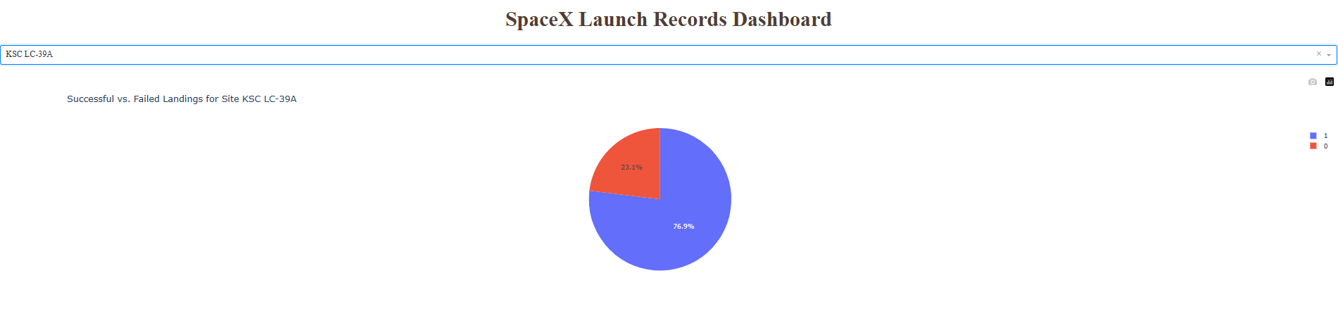
Dashboard – Successful Landings for KSC LC-39A
Image showing the launch site with the highest percentage of successful landings

Slide 44
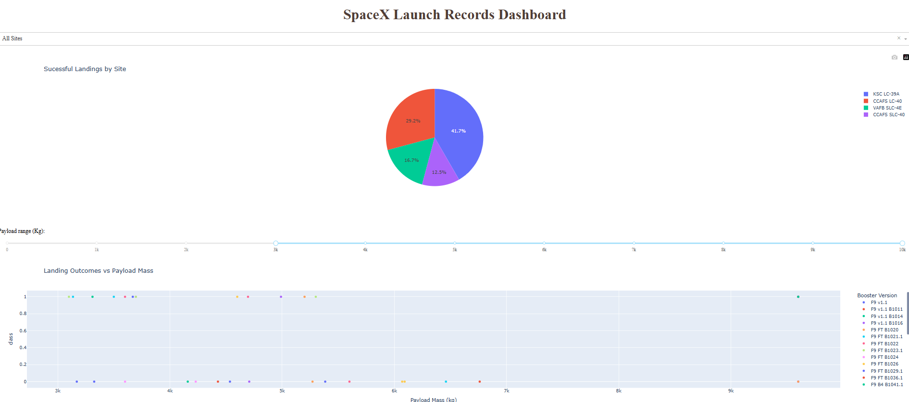
Dashboard
Image showing previously shown pie chart along with scatter plot that shows class vs. payload mass by booster version.

Slide 45

Section 5

Slide 46
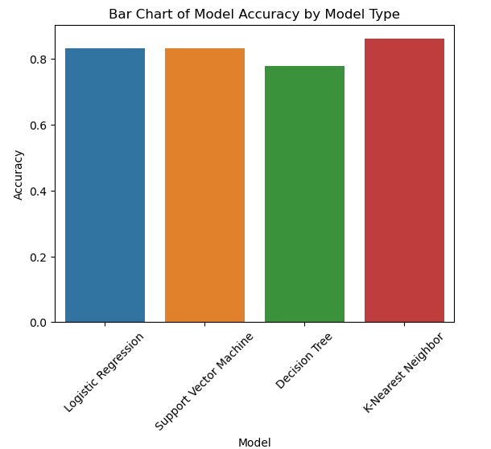
Classification Accuracy
Graph showing model accuracy for each of the model types
K Nearest Neighbor model was most accurate

Slide 47
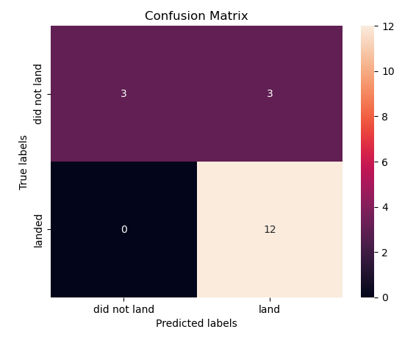
Confusion Matrix
Confusion matrix of the best model

Slide 48
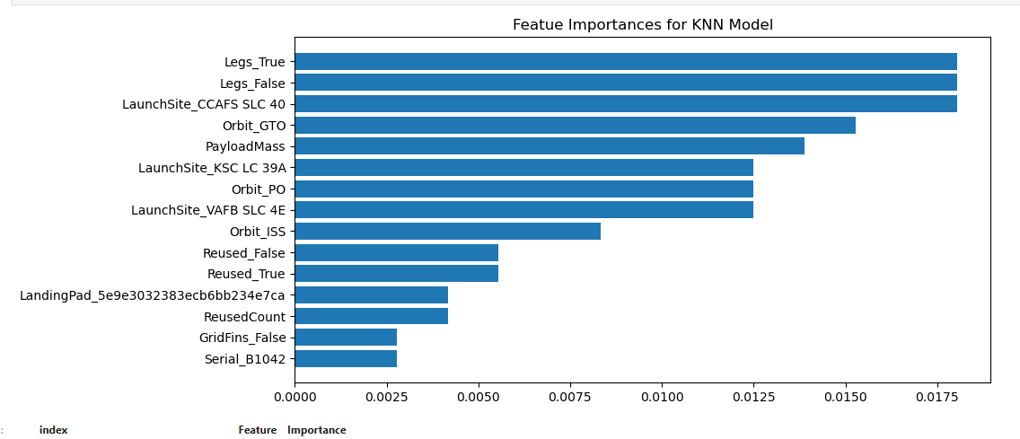
Feature Importance Graph
Graph of feature importance based on amount of change in class given the changes in the various features (Top 15 of 82 features)
Key features are Leg Deployment, Launch Site, Orbit, and Payload
Notes:
Feature Importance or feature importance, depending on whether it should be capitalized or not

Slide 49
Conclusions
The success rate of launches increased over time suggesting iterative learning per launch
Success rate increases when payload gets higher than 8000 kgs
Certain orbit types are more reliable than others
Low, Very Low, and Sun Synchronous orbits are the most reliable orbits
Geostationary transfer orbit is the least reliable orbit
Launch site plays an important role in whether a first stage lands successfully
CCAFS had lowest success rate
VAFB had highest success rate
A Machine Learning model can be used to reliably predict whether Falcon 9 will land or not
Notes:
“to reliably predict whether”

Slide 50
Appendix

Slide 51
Approximating Launch Calculation
Known information:
Approximate cost per launch is $62M ($5,580 M total for 90 launches)
Number of Boosters used out of 90 launches – 53
53 times, the cost was $A(cost of launch with ability to reuse First Stage)
37 times, the cost was $A + x(cost of launch plus the additional cost replace rocket)
Approximation Calculation:
53A + 37(A+x) = 90A +37x = $5,580 (where x is the cost to replace a falcon 9 approximated at $67M)
90A + 37($67) = 5580
90A = 3101
A = ~$35M per Launch

Slide 52


